Slide 1


ENCRYPT TECH
Secure your digital life – Encrypt it all

Slide 2
Group members:
QURAT-UL-AIN AKHTER
HAJRA RAO
NOFAL SHAMEEM
ALI HYDER RANA

Slide 3

SYSTEM ATTRIBUTES
Set up an account
Get a membership
Encryption
Decryption

Slide 4
1
SIGN UP
Let’s create an account if not has any. Enter your name, ID and set-up a suitable password as per the given instructions. Make sure the ID you enter must be unique
LOG IN
Unlock your account and get a chance to avail an amazing opportunity. Just enter your ID, password and then you are in

Slide 5
2
FREE VERSION
Here you can enter any text and get it back in a cipher format. You may share it ahead with any of the concerned person without a 3rd party intervention
PREMIUM VERSION
It’s a way upgraded version where you can also import a text file to be encrypted. In addition, get a chance to maintain a log of your all shared text and files. You may view them anytime you want

Slide 6
3
ENCRYPTION
At this stage your confidential info is carefully taken and scrambled according to the built-in key, so as not to get understood by all
DECRYPTION
On receiving it allows the same key to get your text back into a plain appearance so only a concerned receiver can read it and none other

Slide 7
4
LOAD FUNCTION
In load function all the data from our file will be stored in our vector .
It is called the moment the user runs the program
SAVE FUNCTION
In save function all the data that user enters will be stored in the file It is called when the user exits the program .

Slide 8
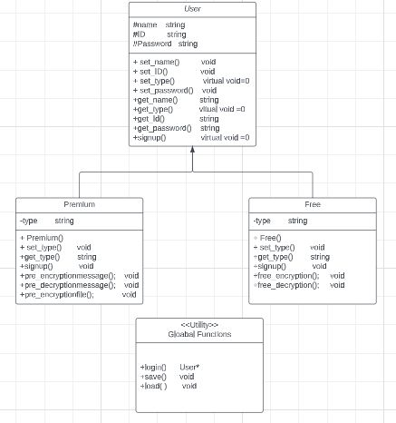
AT A GLANCE

